Slide 1
Eco-Drive for Mobile Application
PIP2001 Capstone Project
FINAL REVIEW
Batch Number: ISE-01
Roll number | Student Name
20211ISE0010 | Sagar M Kodabagi
20211ISE0011 | Madan Gowda I M
20211ISE0013 | Ananya T V
20221LIE0003 | Dhangar Rakesh
Under the Supervision of,
Mr. Saptasi Samyal
Professor
School of Computer Science and Engineering
Presidency University
Name of the Program: Information Science and Engineering
Name of the HoD: Dr. Pallavi R
Name of the Program Project Coordinator: Prof. Srinivas Mishra
Name of the School Project Coordinators: Dr. Sampath A K / Dr. Abdul Khadar A / Mr. Md Ziaur Rahman

Slide 2
Introduction
Environmental pollution from transportation is a major contributor to global carbon emissions, leading to climate change and deteriorating air quality. Many drivers are unaware of their carbon footprint and lack tools to monitor or improve their driving efficiency.
Eco Drive empowers users with tools and information to adopt greener driving habits and reduce their carbon impact. The app provides real-time feedback, personalized tips, and rewards to encourage eco-friendly driving behavior.
Tracks fuel consumption and calculates carbon emissions per trip, offering detailed analytics on driving efficiency
Suggests eco-friendly routes that minimize fuel consumption and travel time.
The goal is to empower drivers with actionable insights while fostering a community committed to sustainable transportation, ultimately making eco-friendly driving easy, rewarding, and impactful for the environment.

Slide 3
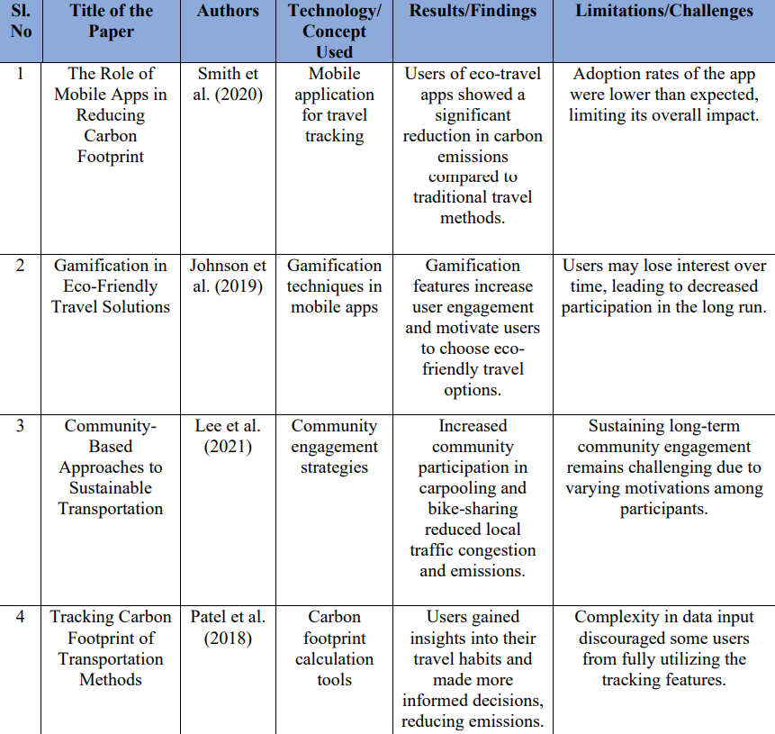
Literature Review

Slide 4
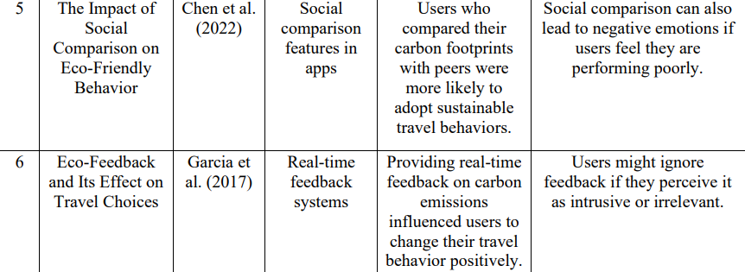
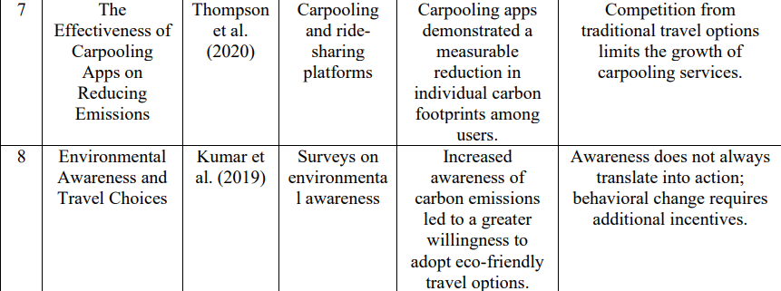
Literature Review

Slide 5
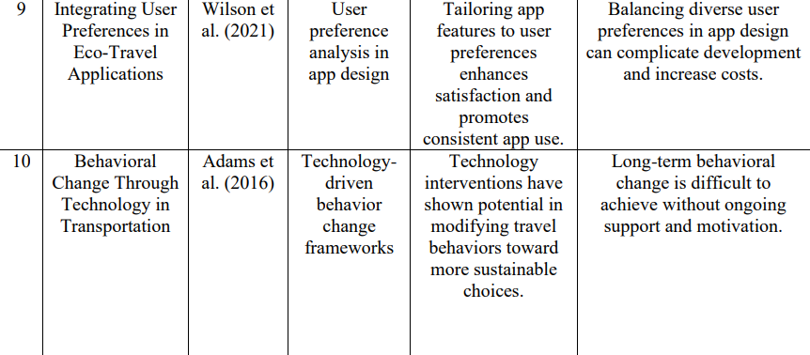
Literature Review

Slide 6
Research Gaps Identified
Limited Real-Time Driving Feedback
Minimal User Engagement
Limited Scalability across Vehicle Types and Regions
Insufficient Focus on Proactive Prevention of Environmental Impact

Slide 7
Proposed Method
The Eco-Drive Mobile App is built using a combination of HTML, CSS, and JavaScript for a dynamic, responsive user interface and Node.js for backend services to ensure smooth performance and efficient request handling.
Real-time Feedback and Analytics are powered by integrated GPS tracking and mobile sensors to monitor driving behavior and provide actionable insights.
Data storage and scalability are managed using Firebase, which supports unstructured data and enables distributed data management for scalability.
Secure Authentication mechanisms are employed to protect user data, using JWT (JSON Web Tokens) for secure session management and privacy compliance.

Slide 8
Objectives
To Provide Real-time Feedback On Driving Behavior
To Create A Reporting System For Driving Efficiency
To Educate Users On Eco-driving Practices
To Leverage Communication For Community Engagement

Slide 9
System Design & Implementation
HTML5 and CSS3 are used for the home, login, and register pages, with JavaScript handling interactivity & form validation.
GPS is used for Location Services
Node.js handles API calls, user authentication, and backend.
JWT encryption secures user data during registration.
Firebase stores user & driver data, chat history, and bookings & payments.

Slide 10
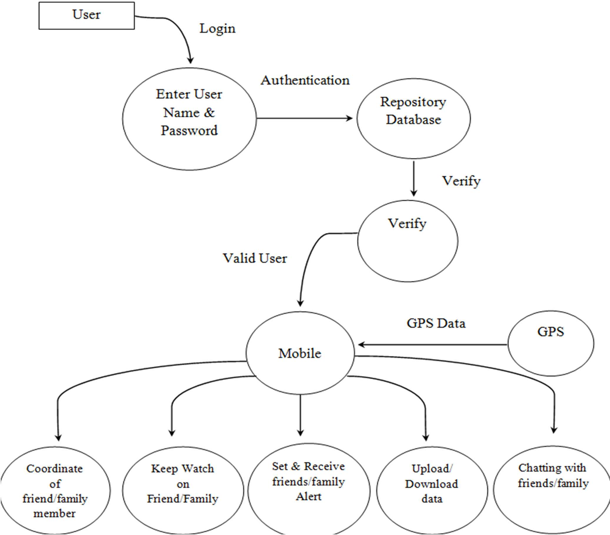
Architecture

Slide 11
Software components
Frontend: HTML5,CSS3, JavaScript
Location Services: GPS
Backend: Node.js
Database: Firebase
Security: JWT

Slide 12
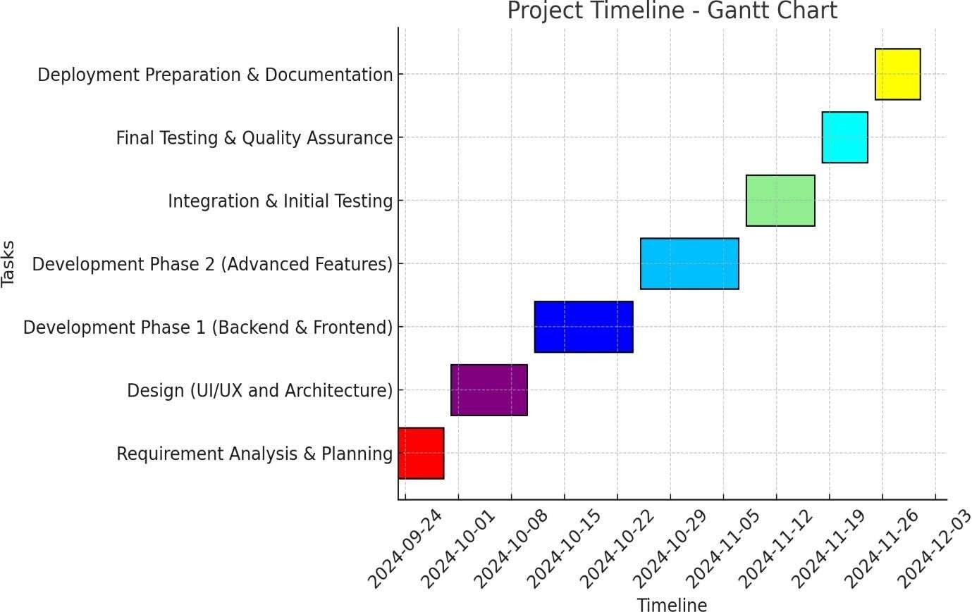
Timeline of Project

Slide 13
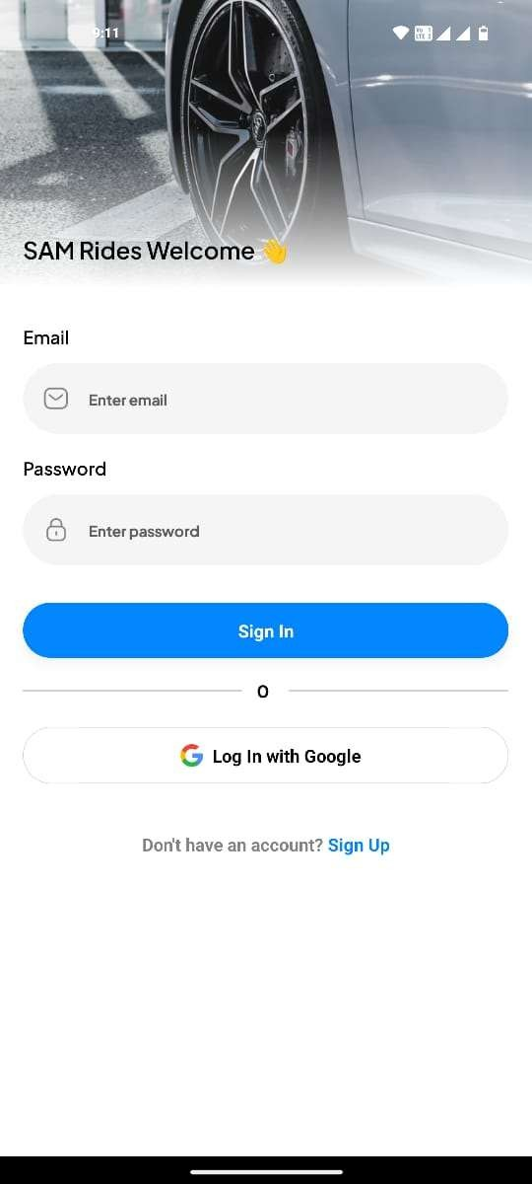
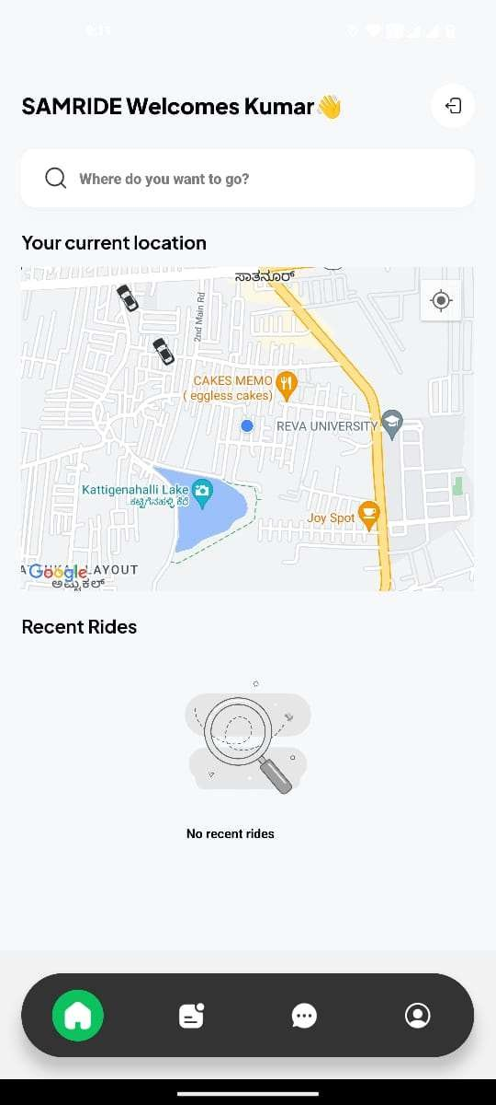
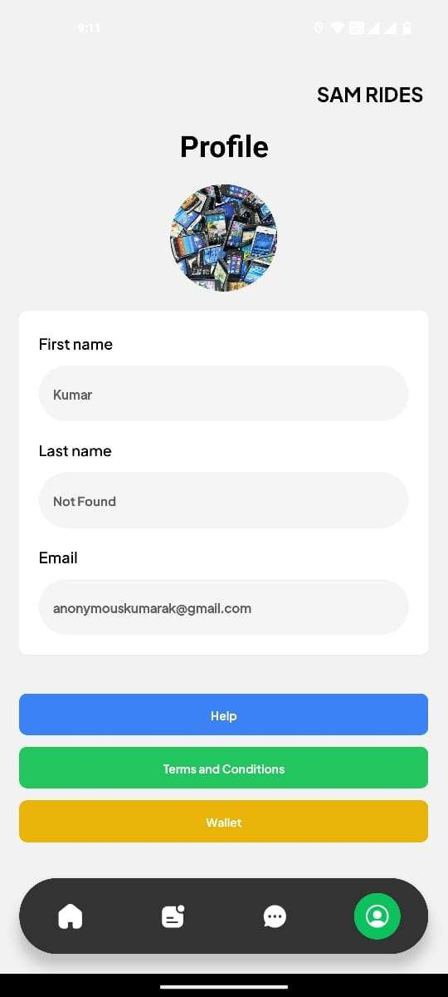
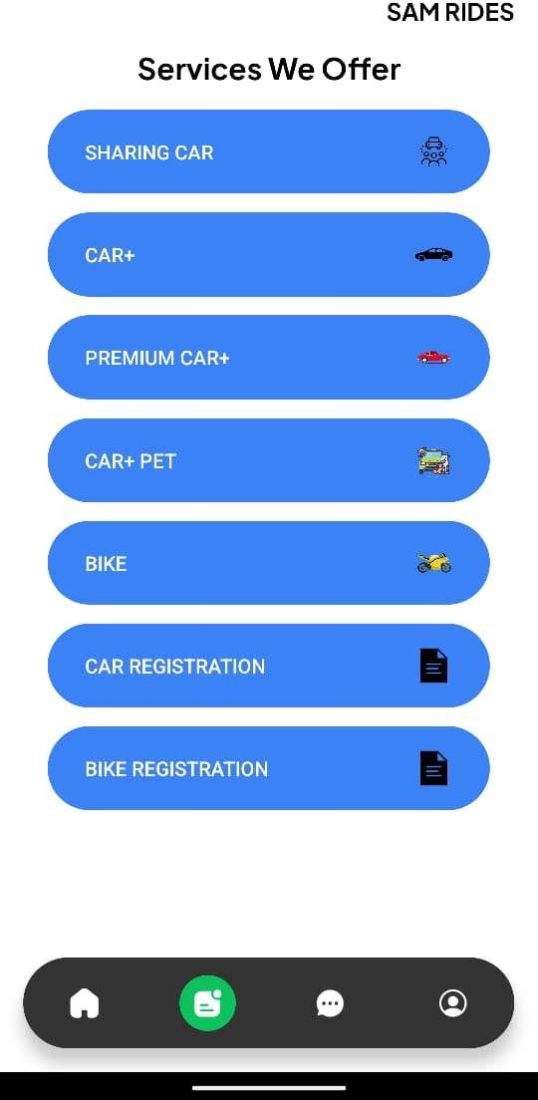
Project’s Results
Third Page
Fourth Page
First Page
Second Page
Eco-Drive APP

Slide 14
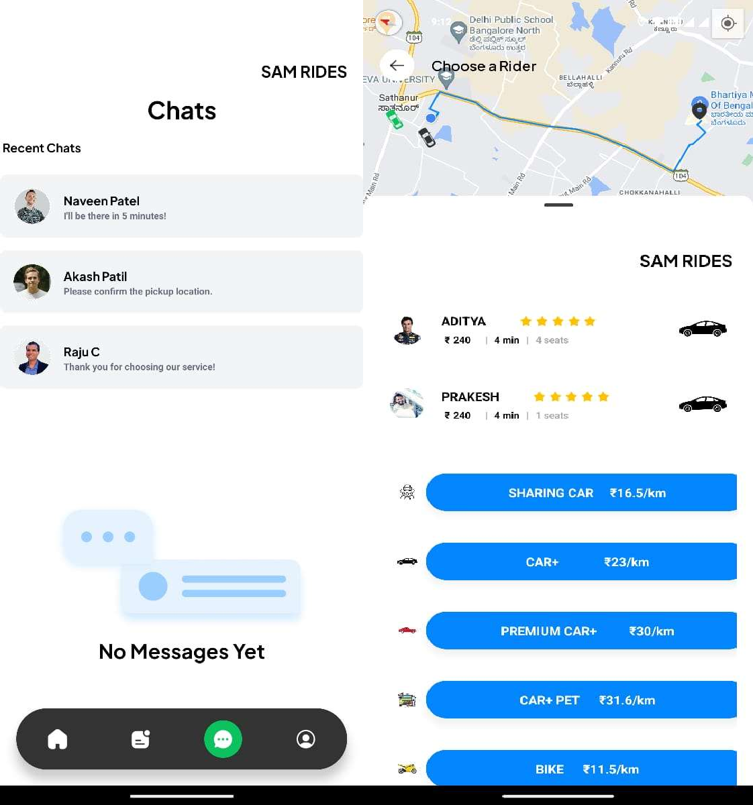
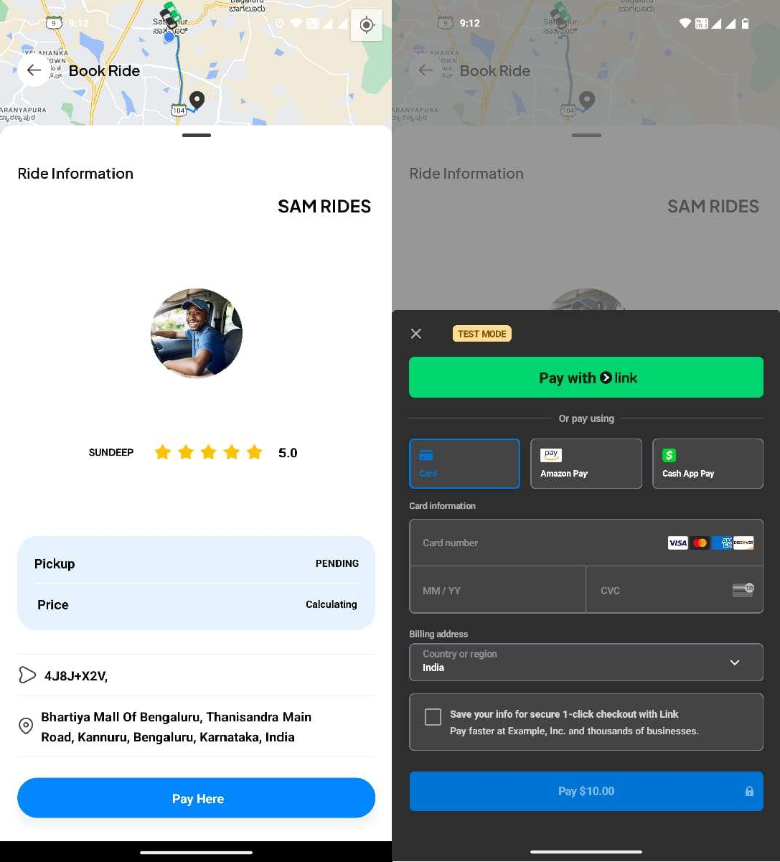
Chats, Bookings & Payment

Slide 15
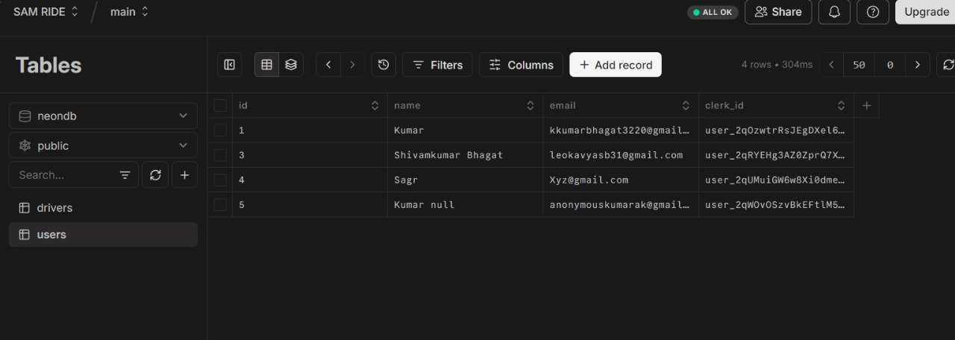
Database for Users

Slide 16
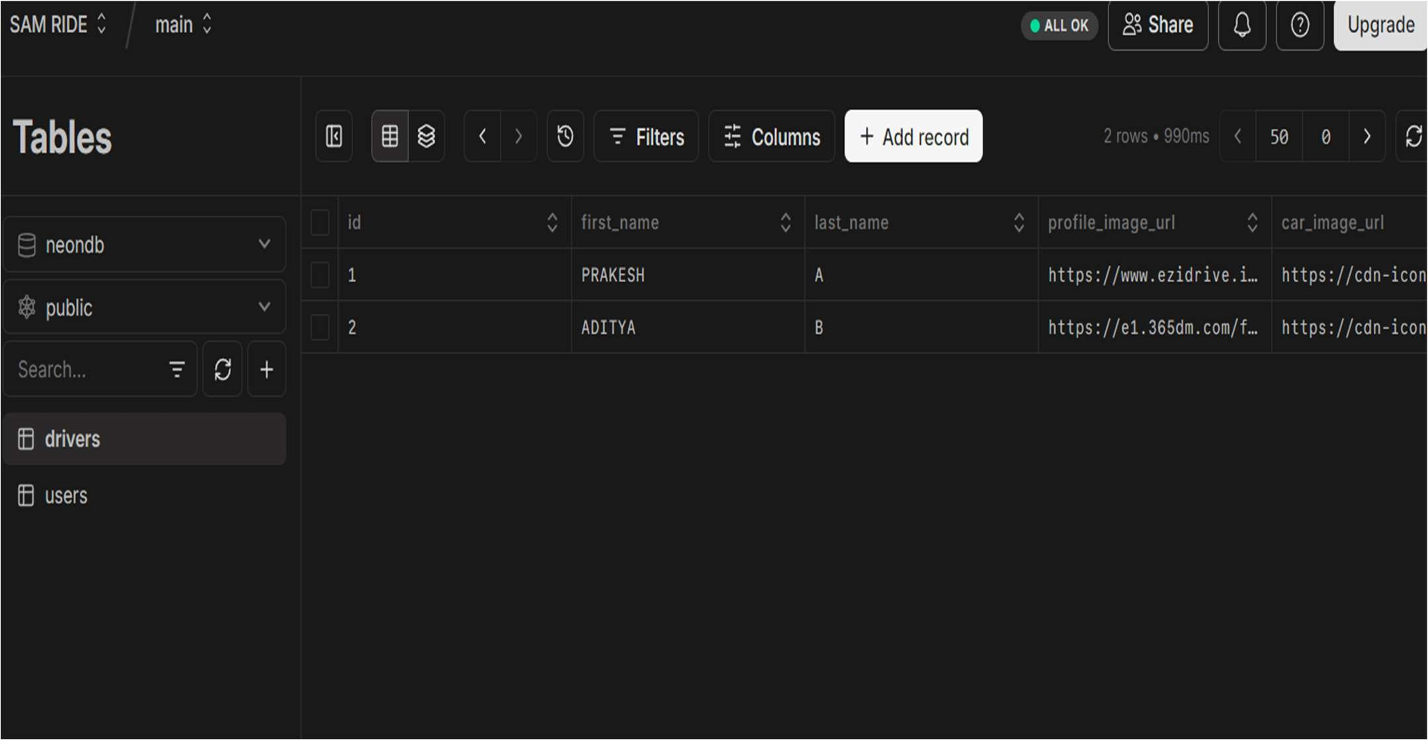
Database for Drivers

Slide 17
Outcomes
Enhanced Transportation Experience
Real-Time Communication
Promotes Shared Mobility
Community Engagement for Eco-Driving
Secure and Reliable System
Scalable Architecture
Real-Time Environmental Impact Statistics

Slide 18
Conclusion
Promotes Sustainable Driving: Encourages fuel-efficient and eco-friendly driving habits.
User-Friendly Design: Simple interface with real-time driving feedback for better user engagement.
Smart Technology Use: Integrates GPS, data analytics, and sensors for accurate performance tracking.
Environmental Benefits: Helps reduce fuel consumption and carbon emissions.
Scalable Solution: Adaptable for both personal and fleet management use.
Future Potential: Opportunities for route optimization, gamification, and smart system integration.

Slide 19
References
[1]. Adams, K., & Martinez, J. (2020). Community Engagement in Green Initiatives: Lessons from Eco Drive Projects. Journal of Urban Studies, 28(3), 134–143.
[2]. Brown, R. (2019). Eco-Driving Techniques for Fuel Efficiency and Emission Reduction. Energy Policy Journal, 47, 112–121.
[3]. Chen, Y., & Lee, H. (2019). The Economic Impacts of Energy-Efficient Vehicles: A Systematic Review. Energy Economics, 56(7), 89–102.
[4]. Clark, D. (2021). Renewable Energy Integration in the Transportation Sector. Renewable Energy Review, 18(2), 156–172.
[5]. Johnson, P. (2018). Behavioral Insights into Eco-Friendly Driving Practices. Transportation Research, 52(3), 87–95.
[6]. Kumar, V., & Sharma, P. (2018). Real-Time Monitoring Systems for Eco Driving: A Technical Review. Transportation Engineering, 33(2), 67–75.

Slide 20
References
[7]. Smith, J., & Green, A. (2020). Driving Sustainability: The Role of Technology in Reducing Emissions. Journal of Environmental Science, 35(4), 254–265.
[8]. Thompson, E. (2020). Public Perception and Policy Support for Eco-Friendly Driving Initiatives. Environmental Psychology, 29(5), 213–229.
[9]. Upadhyay, U., & Sharma, G. (2022). Challenges in Scaling Eco-Friendly Driving Solutions in Urban Areas. Journal of Environmental Solutions, 12(4), 88–99.
[10]. Zhao, L., & Wang, X. (2019). Urban Mobility and Environmental Sustainability: A Data-Driven Approach. Environmental Modelling, 44(6), 301–310.
[11]. Morin, H. K., Bradshaw, C. P., & Kush, J. M. (2018). Adjustment Outcomes of Eco-Friendly Driving Practices. Journal of Sustainable Transportation, 70, 74–88.
[12]. Banister, D. (2018). Reducing Transport Emissions through Active Mobility Strategies. Transport Policy, 32(1), 76–84.
[13]. Axsen, J., & Kurani, K. S. (2019). Social Influence and Consumer Preferences in Sustainable Driving Choices. Transportation Research Part D: Transport and Environment, 68, 52–67.

Slide 21
References
[14]. Schuitema, G., Anable, J., & Skippon, S. (2013). Influencing the Acceptance of Energy- Efficient Mobility Solutions. Energy Policy, 52, 135–146.
[15]. Hall, D., & Lutsey, N. (2020). The Evolution of Electric Vehicles: Policy and Market Trends.International Council on Clean Transportation (ICCT). Retrieved from https://theicct.org
[16]. Albrecht, S., & Arts, J. (2021). The Role of Incentives in Promoting Eco-Driving Practices. Journal of Policy Research in Transportation and Environment, 29(2), 155–168.
[17]. Sorrell, S., & Dimitropoulos, J. (2008). The Rebound Effect in Transport: A Critical Review. Energy Policy, 36(8), 2637–2651.
[18]. Hooftman, N., Messagie, M., Van Mierlo, J., & Coosemans, T. (2016). A Review of the Environmental Performance of Alternative and Renewable Transportation Fuels. Renewable and Sustainable Energy Reviews, 57, 778–796.
[19]. McIlvaine, J. (2022). Behavioral Modeling for Reducing Carbon Footprints in Transport. Journal of Green Technologies in Transportation, 17(3), 123–145.

Slide 22

Project work mapping with SDG
SDG 7: Affordable and Clean Energy
SDG 11: Sustainable Cities and Communities
SDG 13: Climate Action

Slide 23
Thank You

